Slide 1
Confounding and Stratification
Dealing with confounding

Slide 2
        Exposures and outcomes
In an epidemiological study there is:
(a) the outcome of interest
(b) the primary exposure (or risk factor)
of interest
(c) other exposures that may influence
the outcome (potential confounders)

Slide 3
        Exposures and outcomes
You will need to measure more than one exposure
Because you do not know which exposures are
likely to be risk factors for the disease i.e. you do not know which exposures are “primary”
Because some exposures
may ‘get in the way’ when trying to sort out a
relationship between
primary exposure and
outcomes i.e. they may
act as confounding factors

Slide 4



Question: Is alcohol consumption during pregnancy associated
with increased risk of low birthweight ?
Alcohol during pregnancy
exposure
Low birth weight
outcome
Diet during pregnancy
potential confounding factor

Slide 5
Confounding is about
ALTERNATIVE EXPLANATIONS
FOR AN EFFECT SEEN
- when an association between the Exposure under
investigation and Outcome is “mixed up” with the effect of
another exposure (or exposures)
- when the effects of the two exposures have not been considered separately

Slide 6
Example :
Occupational Cohort study of Lorry (Truck) Drivers
Exposure: Lorry driving as a job
Comparison cohort: England and Wales population
(national statistics office)
Outcome : Coronary Heart Disease mortality
Crude Rate Ratio of 3.0 (or SMR of 300)

Slide 7
Crude RR=3
Exposure
Lorry Driving
Outcome
Death from CHD
Another factor

Slide 8
Crude RR=3
Exposure
Lorry Driving
Outcome
Death from CHD
Survey found
that lorry
drivers more
likely to be
overweight
general
population
RR=5
Another factor
Overweight

Slide 9

The “crude “ rate ratio of 3 is likely to change is we
make allowance for the effect of overweight
Will it go
UP (above 3 )?
or
DOWN (below 3) ?

Slide 10
Definition: for a factor to be regarded as a confounder the rules are:
EXPOSURE OUTCOME
CONFOUNDER
1. The factor must be associated with the exposure being investigated
2. The factor must be independently associated with the disease being
investigated.
3. The confounder is not on the causal pathway.

Slide 11
How to deal with confounding
Need to display the data separately for each level
of the confounding factor
Then examine the measures of effect within each
level (or strata)
If they different from the “crude” measure of effect,
but similar to each other, this is evidence of confounding
BUT no test for confounding.

Slide 12

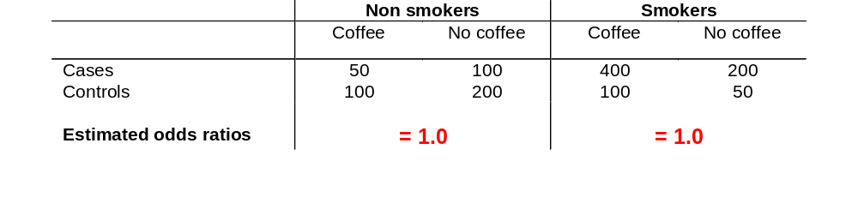
Example: Case-control study of coffee consumption and cancer
of the pancreas
Stratification

Slide 13
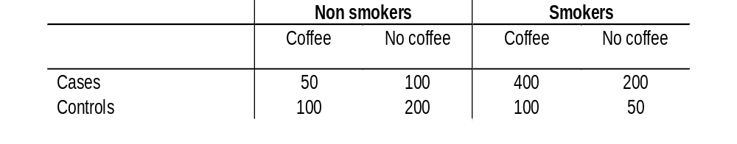
We have shown that the “stratified” measure of effect (in this case
odds ratios) are different from the “crude” measure of effect,
but similar to each other
Thus we have evidence that Smoking was acting as a confounding
factor
Question: What is the odds ratio for the effect of
Smoking on the risk of cancer of the pancreas?
Use data from table below:
Answer= (600 * 300 ) / (150* 150) = 8

Slide 14
“Adjusted “ OR=1.0
Crude OR=1.9
Exposure
Coffee
Outcome
Cancer of the pancreas
Crude OR=8.0
Another factor
Smoking

Slide 15
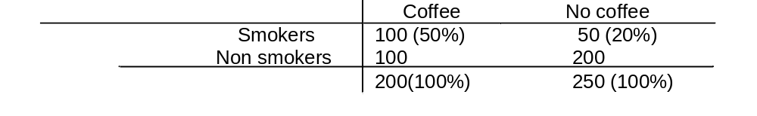
If we investigate the control data further, we can see
that the confounding factor
is associated with the exposure under investigation:
1 in 2 coffee drinkers are smokers
1 in 5 non-coffee drinkers are smokers

Slide 16
This example demonstrated complete confounding where ALL the association between coffee drinking and cancer of the pancreas could be“explained” by smoking
i.e: OR of 1.9 was reduced to 1.0
Other examples may give PARTIAL confounding
i.e: Rate Ratio of 2.5 was reduced to 2.0
But remember that measures of effect can go
UP as well as DOWN : NEGATIVE confounding

Slide 17
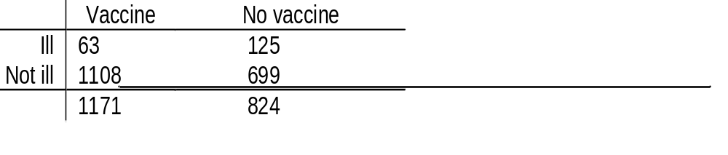
Example: In a study of the effect of vaccination against pertussis,
household contacts of cases were followed up. Among those aged
under 6 the following results were obtained
Crude risk ratio= 0.35
We would like to know how age effects this relationship-
asking the question is age confounding this estimate?

Slide 18
Stratify (split ) the data according to levels of the
Suspected confounding factor (age in this example)
Age group | Vaccinated Ill/total | Not vaccinated Ill/total | Risk Ratio
0 | 4/27 | 7/28 | 0.59
1 | 10/106 | 29/130 | 0.42
2-3 | 21/326 | 61/339 | 0.36
4-5 | 28/712 | 28/327 | 0.46
Summarise this by calculating a weighted mean of the
risk ratios = 0.41 (95% CI 0.31-0.56)

Slide 19
Crude risk ratio= 0.35 (95% CI 0.27-0.48)
Adjusted risk ratio = 0.41 (95% CI 0.31-0.56)
There is a difference between the crude and adjusted estimates,
and we can say that age does act as a confounder in these data
But how much of a difference matters?
No formal statistical test for confounding !

Slide 20
Summarising the stratum-specific measures of effect
To produce an “adjusted” estimate which “allows for” or
“controls for” the effect of the confounding factor (s)
The method is to produce a weighted mean of the
stratum-specific estimates of effect where the
weights relate to the numbers in each stratum
One common method is Mantel-Haenszel
Another is Standardisation
Logistic regression can also be used to adjust for confounding.

Slide 21
Factors on the Causal Pathway
Rather than providing an ALTERNATIVE explanation,
a factor may provide an ELABORATION of explanation.
EXPOSURE FACTOR X DISEASE
Water source
Gut pathogens
Diarrhoea
The new factor may be on the CAUSAL pathway to disease
In this situation the factor is NOT acting as a confounder
But it is providing further explanation of the association

Slide 22
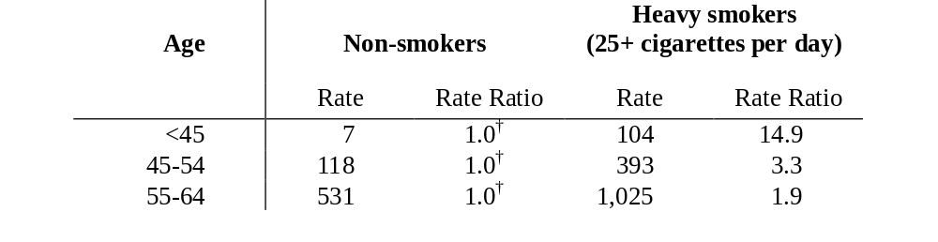
Interaction or Effect Modification
Data from British doctors study on heart disease and smoking
Rates per 100,000 men and rate ratios
Rate ratios vary according to different levels of the “third” factor-
In this example age. There IS a statistical test for this
In this situation is in NOT appropriate to summarise the measures
of effect into one summary estimate. There is INTERACTION.

Slide 23
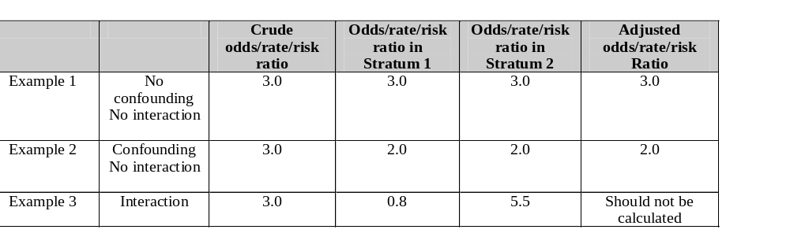
INTERACTION ( EFFECT MODIFICATION )
verses
CONFOUNDING

Slide 24
Residual Confounding
Although there are methods to control for confounding
the quality of the “allowance” or “adjustment” can only be
as good as the quality of the data used
For example: if we control for age using 20 year age bands,
there will probably be residual confounding by age in the data
This is called “residual “ ( “left-over”) confounding

Slide 25

How to deal with confounding
At the Design Stage
Randomisation
Restriction
Matching
At the Analysis Stage
Stratification
Standardisation
Statistical modelling
eg logistic regression
But need to have collected the data…...

Slide 26
FURTHER ANALYSIS OF 2X2 TABLES
Mantel-Haenszel methods:
Mantel-Haenszel technique to obtain OR_{MH} adjusted for confounding factor.
2. Mantel-Haenszel χ² to test whether adjusted OR = 1.

Slide 27
Case-control study of coffee drinking and pancreatic cancer
Case Control
coffee yes 450 440
drinking no 300 410
Total 750 850
Crude OR = ad / bc = 450x410 / 440x300 = 1.40.
Suggests risk of pancreatic cancer associated with coffee drinking.

Slide 28
OR=1.40
Possible explanations:
Chance:
χ² (O-E) = 10.62, p=0.001 => chance is unlikely.
Bias:
OR = 1.40 does not represent the true OR.
Confounding:
OR = 1.40, but due to effect of other variable.
Causation:
OR = 1.40 reflects true association.

Slide 29
Look within stratum of confounding variable:
Smokers Non-smokers
case control case control
coffee yes 400 340 50 100
no 200 190 100 220
Total 600 530 150 320
Is smoking associated with increased risk of pancreatic cancer?
600 (80%) of the 750 cases are smokers
530 (62%) of the 850 controls are smokers

Slide 30
Look within stratum of confounding variable:
Smokers Non-smokers
case control case control
coffee yes 400 340 50 100
no 200 190 100 220
Total 600 530 150 320
Are coffee drinkers more likely to smoke?
Among controls…
340 of the 440 coffee drinkers are smokers (77%)
190 of the 410 non-coffee drinkers are smokers (46%)

Slide 31
Mantel-Haenszel Odds Ratio
Crude OR=1.4 is misleading. Calculate separate OR’s…
Smokers Non-smokers
case control case control
coffee yes 400 340 50 100
no 200 190 100 220
Total 600 530 150 320
OR = 400x190/340x200 = 1.12 OR = 50x220/100x100 = 1.10
But more interested in combined estimate of OR….

Slide 32
Mantel-Haenszel OR_{MH} is weighted average of OR’s in each stratum:
STRATUM 1 STRATUM 2
disease disease
Y N Y N
exposed Y a₁ b₁ | a₂ b₂ |
N c₁ d₁ | c₂ d₂ |
---------------- ---------------
| n₁ | n₂
OR_{MH} = a₁d₁/n₁ + a₂d₂/n₂ ∑ a_{i}d_{i}/n_{i} ---------------------- In general, ------------ b₁c₁/n₁ + b₂c₂/n₂ ∑ b_{i}c_{i}/n_{i}

Slide 33
disease disease
Y N Y N
exps Y a₁ b₁ | a₂ b₂ |
N c₁ d₁ | c₂ d₂ |
------------------ ------------------
| n₁ | n₂
OR_{MH} = a₁d₁/n₁ + a₂d₂/n₂ ---------------------- b₁c₁/n₁ + b₂c₂/n₂
disease disease
Y N Y N
exps Y 400 340 | 50 100 |
N 200 190 | 100 220 |
------------------ ------------------
| 1130 | 470
OR_{MH} = (400x190)/1130 + (50x220)/470 = 1.11
-------------------------------------------
(340x200)/1130 + (100x100)/470

Slide 34
disease disease
Y N Y N
exps Y 400 340 | 50 100 |
N 200 190 | 100 220 |
------------------ ------------------
| 1130 | 470
OR_{MH} = (400x190)/1130 + (50x220)/470 = 1.11
-------------------------------------------
(340x200)/1130 + (100x100)/470
Odds of coffee drinking is 11% higher among cases than controls.
This is the stratified estimate (recall crude OR was 1.4)

Slide 35
Significance test of stratified OR: Mantel-Haenszel χ² test
H₀: OR_{MH} = 1.
i.e. no association between exposure and disease within any strata.
For each table:
disease
Y N
exps Y a b | e
N c d | f
-------------------
g h | n
Observed value of a
ii) Expected value of a (assuming H₀: of no association): Ea = eg / n
iii) Variance of a (assuming H₀: no association): Va = efgh / {n²(n-1)}.

Slide 36
Calculate Ea and Va:
a Ea=eg/n Va=efgh/{n²(n-1)}
----------------------------------------------------------------------------------------
Smokers 400 392.9 63.7
Non-smokers 50 47.9 22.2
----------------------------------------------------------------------------------------
Total 450 440.8 85.9
Under H₀: difference between Σa and ΣEa should be small and follow χ² distribution (on 1.d.f):
χ²_{MH} = ( | ∑a - ∑Ea | - 0.5 )² / ∑Va
χ²_{MH} = (|450 - 440.8| - 0.5)² / 85.9 = 0.88 on 1 d.f.
P>0.30 No evidence of association

Slide 37
Mantel Haenszel using R
mymatrix1 <-matrix(c(400,340,200,190),nrow=2,byrow=TRUE)
colnames(mymatrix1) <- c("Disease","Control")
rownames(mymatrix1) <- c("Exposure","Unexposed")
print(mymatrix1) # to get the stratified table
mymatrix2 <- matrix(c(50,100,100,220),nrow=2,byrow=TRUE)
colnames(mymatrix2) <- c("Disease","Control")
rownames(mymatrix2) <- c("Exposure","Unexposed")
print(mymatrix2) # to get the stratified table

